Slide 1
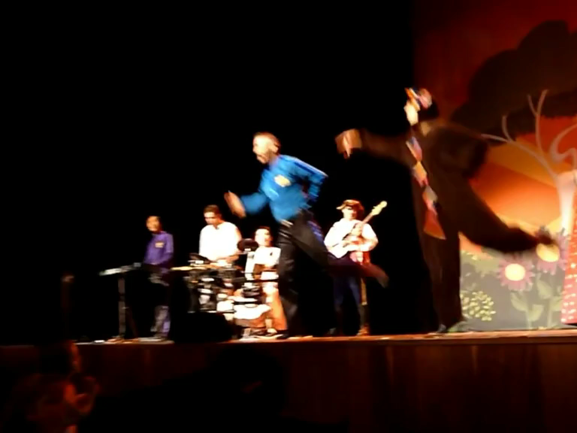
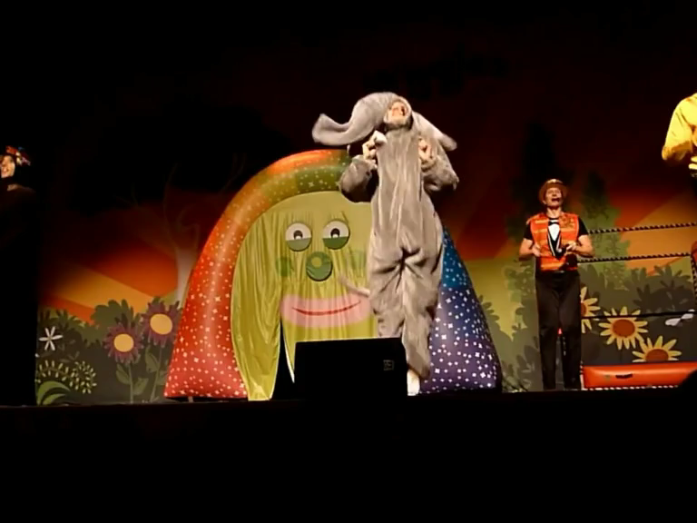
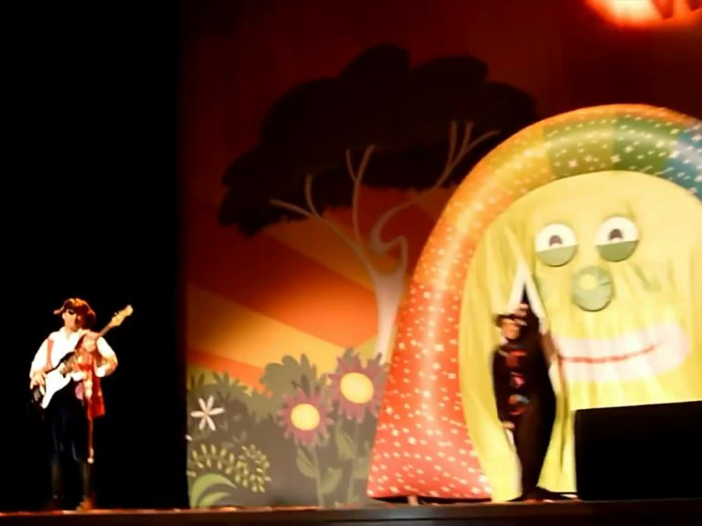
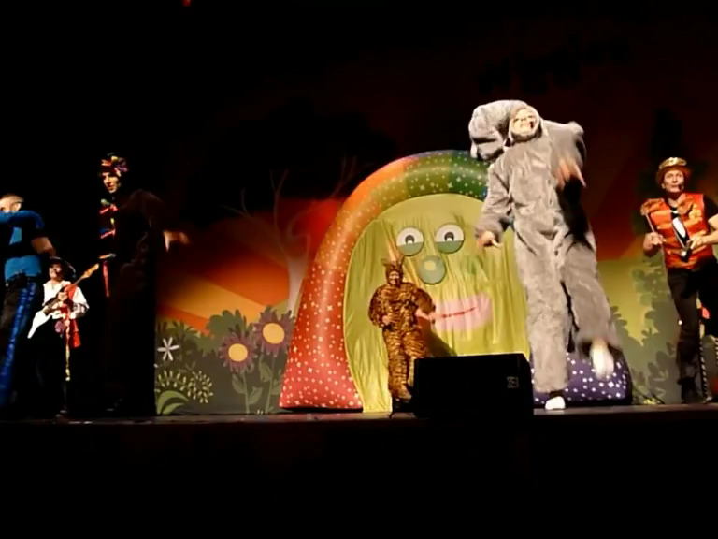
THE MONKEY DANCE
We're gonna do the monkey (oh oh ah ah oh oh ah ah)
Do the monkey (oh oh ah ah oh oh ah ah)
Monkey, Monkey (oh oh ah ah oh oh ah ah)
That's alright
Do the elephant (whreeeew)
Do the elephant (whreeeew)
Do the elephant (whreeeew)
That's alright
Jump to the front and the back (oh oh ah ah oh oh ah ah)
Jump to the front and the back (oh oh ah ah oh oh ah ah)
Come on and jump to the front and the back (oh oh ah ah oh oh ah ah)
Do the tiger (roar)
Do the tiger (roar)
Tiger, Tiger (roar)
That's alright

